Slide 1
Next-Gen Transport
PoC July 2024

Slide 2
Major Technologies
Constrained Application Protocol (CoAP)
Standardized in RFC 7252
HTTP-like request/response semantics
Embedded-friendly
Public Key Cryptography
Datagram TLS (DTLS)
Root Certificate Authority (CA) for a system and chain of trust
JSON Web Tokens (JWT)
Standardized in RFC 7519
Present a token that certifies that the bearer has certain rights
Signed either with pre-shared key (HMAC) or PKI (RSA, ECDSA)

Slide 3
Component Roles
Arbiter
Is discoverable via mDNS
Maintains a list of Controllers and Devices on a system
Maintains ACLs which determine which Controllers are allowed to control what on which Devices
Gives control tokens (JWT) to Controllers on request
Controller
Requests list of Devices from Arbiter
Requests control tokens from Arbiter to control Devices
Connects to Devices and presents its control token with requests
Devices
Registers with Arbiter
Receives connections from Controllers
Verifies control token presented by Controller before allowing control

Slide 4
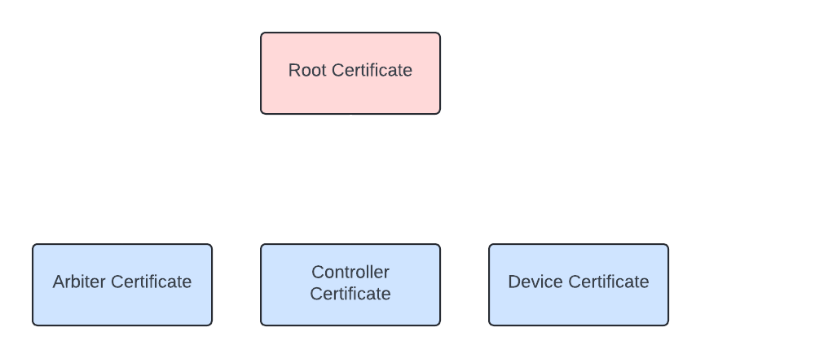
Distribution of Certificates
To participate in the system, you need a certificate signed by the root certificate

Slide 5
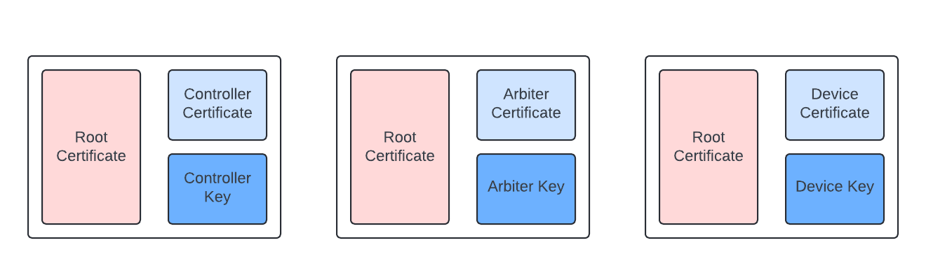
Distribution of Certificates
Root Key is not provisioned on any device.
It is kept securely and only used for signing certificates for newly-provisioned devices.

Slide 6
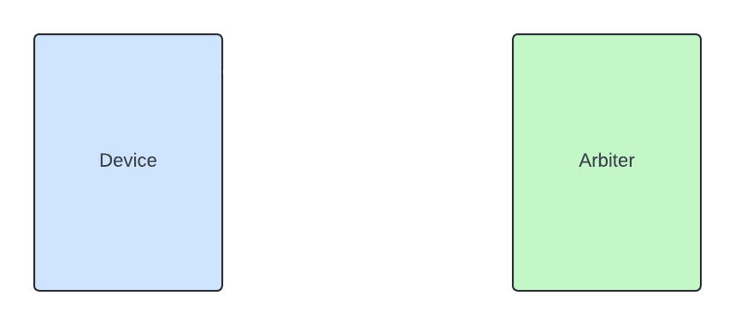
Device -> Arbiter Connection and Registration

Slide 7
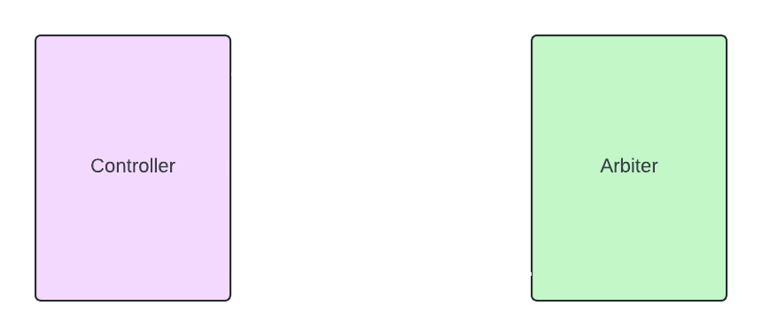
Controller -> Arbiter Connection and Discovery

Slide 8
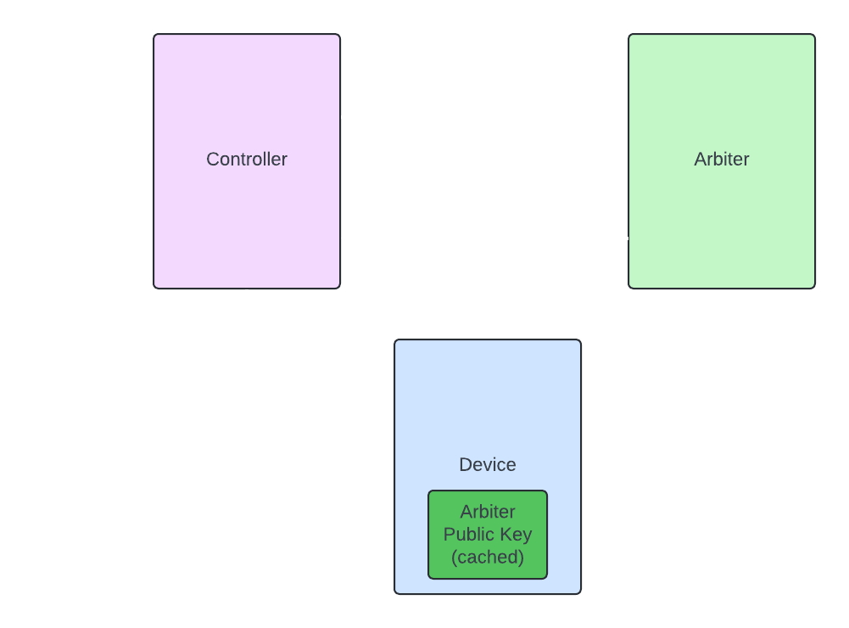
Controller -> Arbiter -> Device Control
Device caches Arbiter’s public key from its initial connection to Arbiter. It knows this public key is valid because it was signed with the root CA.

Slide 9
Anatomy of a Control Token (JWT)
{
"iss": "49af3cac-8f70-40e6-9e6d-7ca46c6d68ef",
"sub": "2cf35b8e-7459-4cab-844e-b44eba94485e",
"aud": "d127abfe-3cab-4ee1-9e19-1332257515c5",
"exp": 1720760282,
"params_read": [
"readable-param"
],
"params_write": [
"writable-param"
]
}
Issuer (CID of Arbiter)
Subject (CID of Controller)
Audience (CID of Device)
Expiration (Timestamp after which token is no longer valid)
Parameters for which this token allows read access
Parameters for which this token allows write access

Slide 10
Demo

Slide 11
Design Considerations
In order to keep the system secure:
Control tokens must expire in a relatively short time (e.g. < 1 day)
This time may need to be adjusted for usage considerations (e.g. it needs to last through the show)
Everyone on the network must have synchronized time (does not have to be too precise)
The Arbiter must be available to issue new control tokens so that the system remains controllable
The Arbiter may not always be a show-critical component if token timeouts are adjusted correctly (see above)

